Slide 1
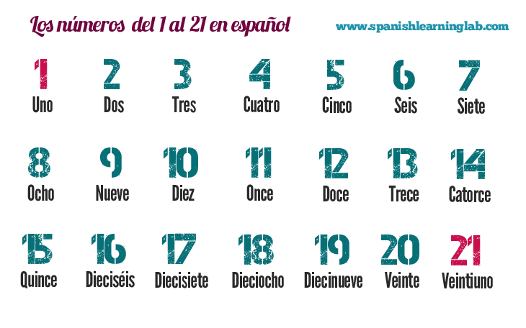
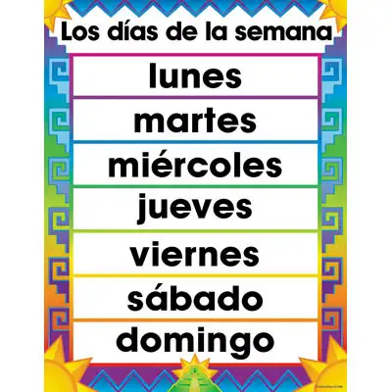
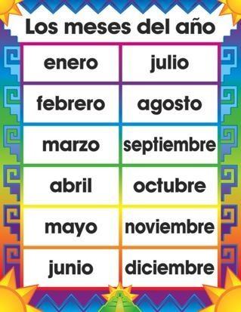
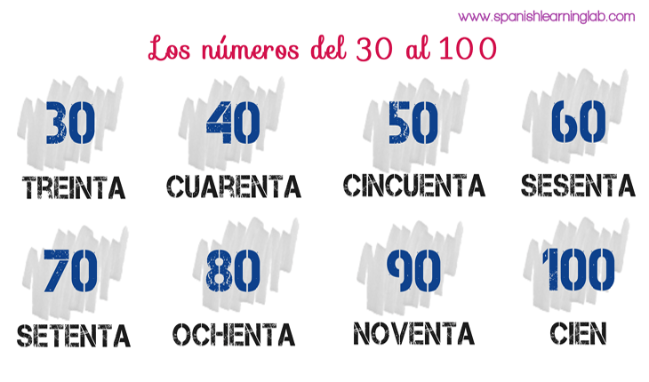

Slide 2
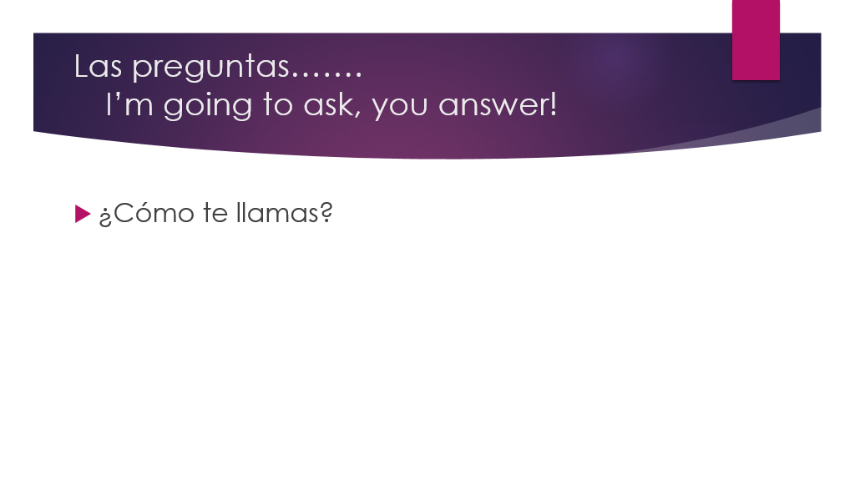

Slide 3
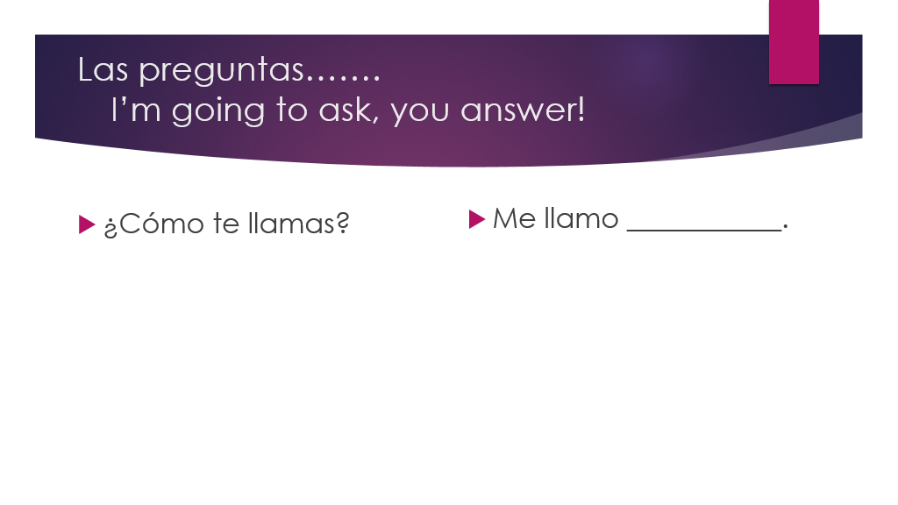

Slide 4
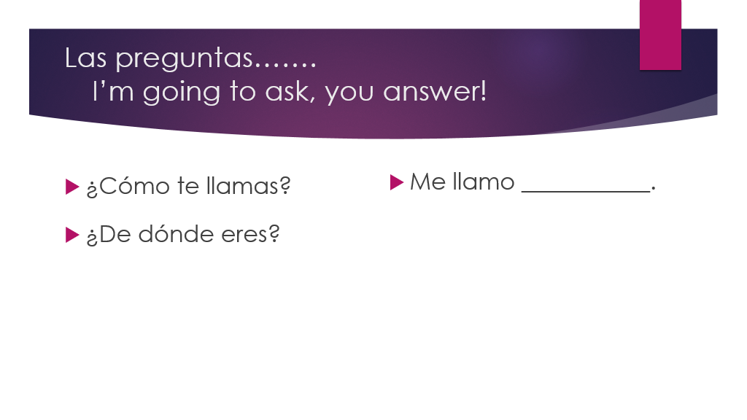

Slide 5
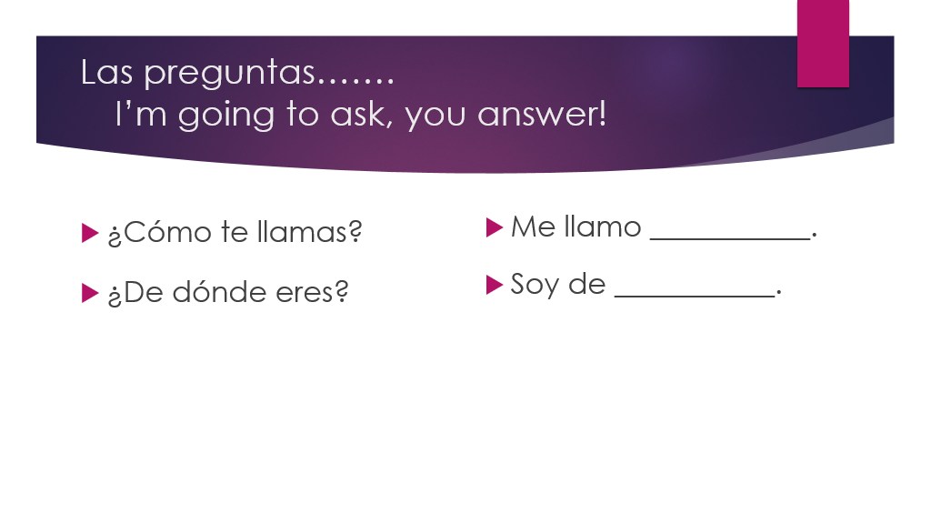

Slide 6
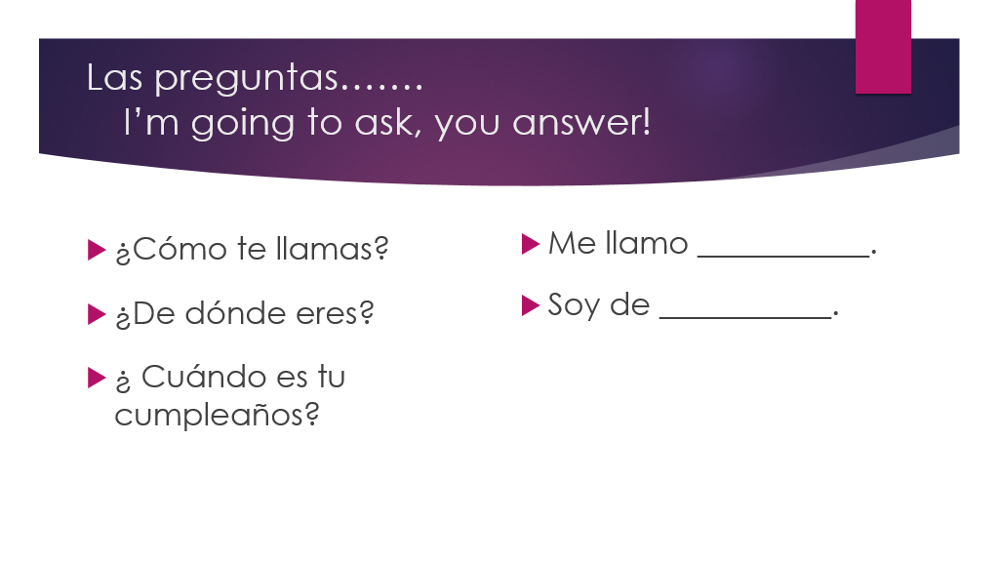

Slide 7
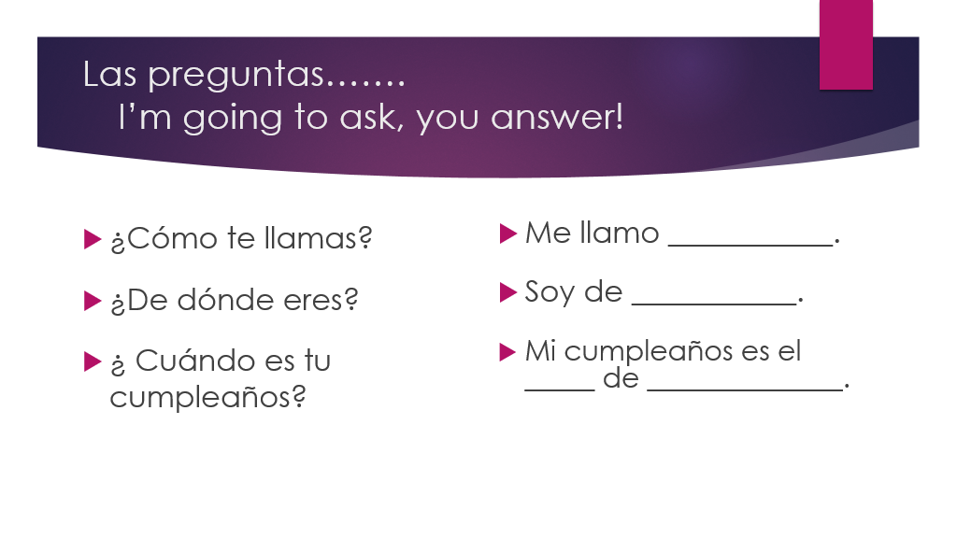

Slide 8
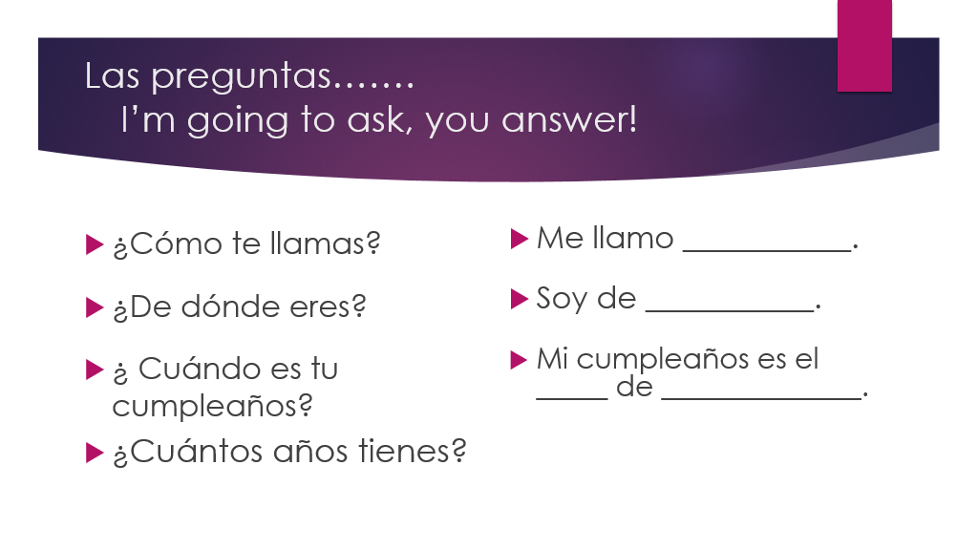

Slide 9
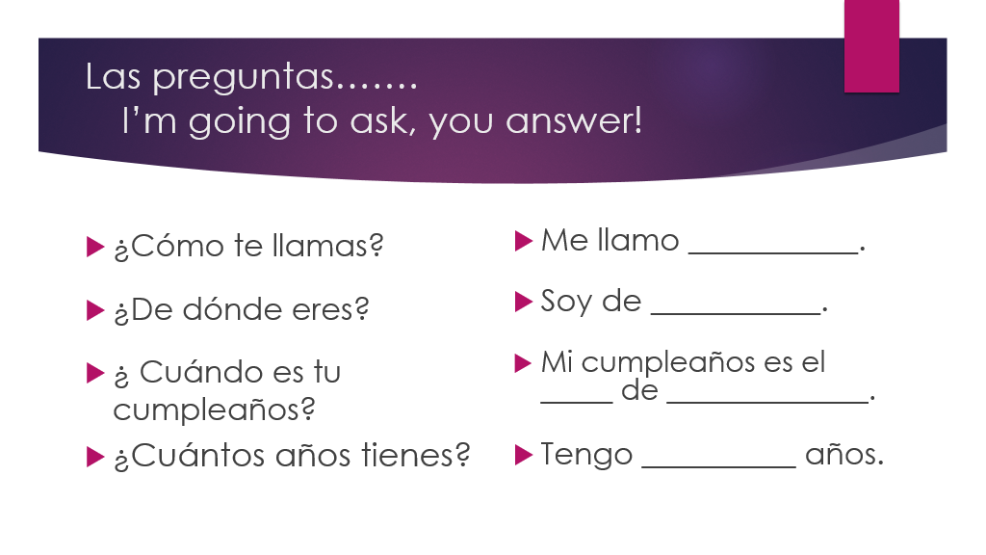

Slide 10


Slide 11
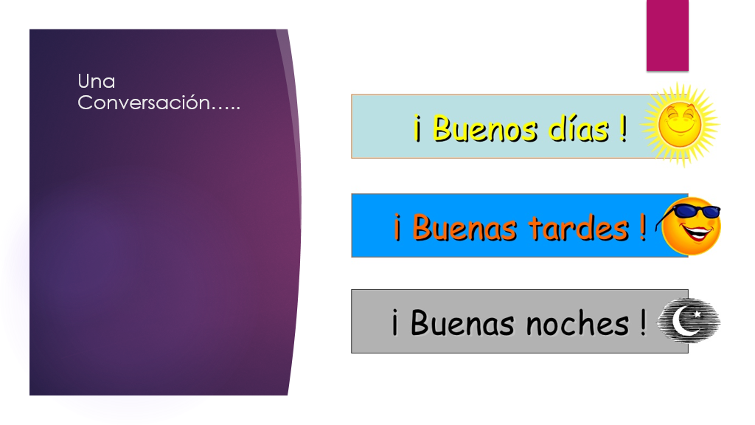

Slide 12
Greetings
¡Hola! = Hello! or Hi!
¡Bienvenidos! = Welcome!
Mucho gusto = Nice to meet you.
Encantado(a) = Charmed
Igualmente = Likewise; equally
¿Qué tal? = How’s it going? / What’s up?
¿Qué pasa? = What’s up?
¿Y tú / Y Ud.(Usted)? = And you?
SEÑOR, SEÑORA y SEÑORITA: MR., MRS., MS.
Sr. Sra. Srta.

Slide 13
Question #5 ¿Cómo estás?
Fantástico(a) Excelente
Muy bien Fabuloso(a)
Bien
Regular Normal
Así Así Más o Menos
Mal Horrible
Terrible Fatal

Slide 14
Goodbyes
¡Adiós! = Goodbye!
¡Buenas tardes! /¡Buenas noches! = Good night!
¡Hasta luego! = See you later!
¡Nos vemos (pronto)! = We´ll see each other soon!
¡Hasta mañana! = See you tomorrow!
¡Hasta pronto! = See you soon!
¡Hasta la vista! = See you!
¡Chao! = Good bye!

Slide 15
Una conversación extraña….
Greet your partner
Respond and ask “¿y tú?
Respond, tell your partner where you are from and then ask your partner where they are from?
Say farewell.
Respond to your partner and ask how they are doing.
Respond. Tell your partner your name and ask your partner their name.
Respond. Then say a farewell.

Slide 16
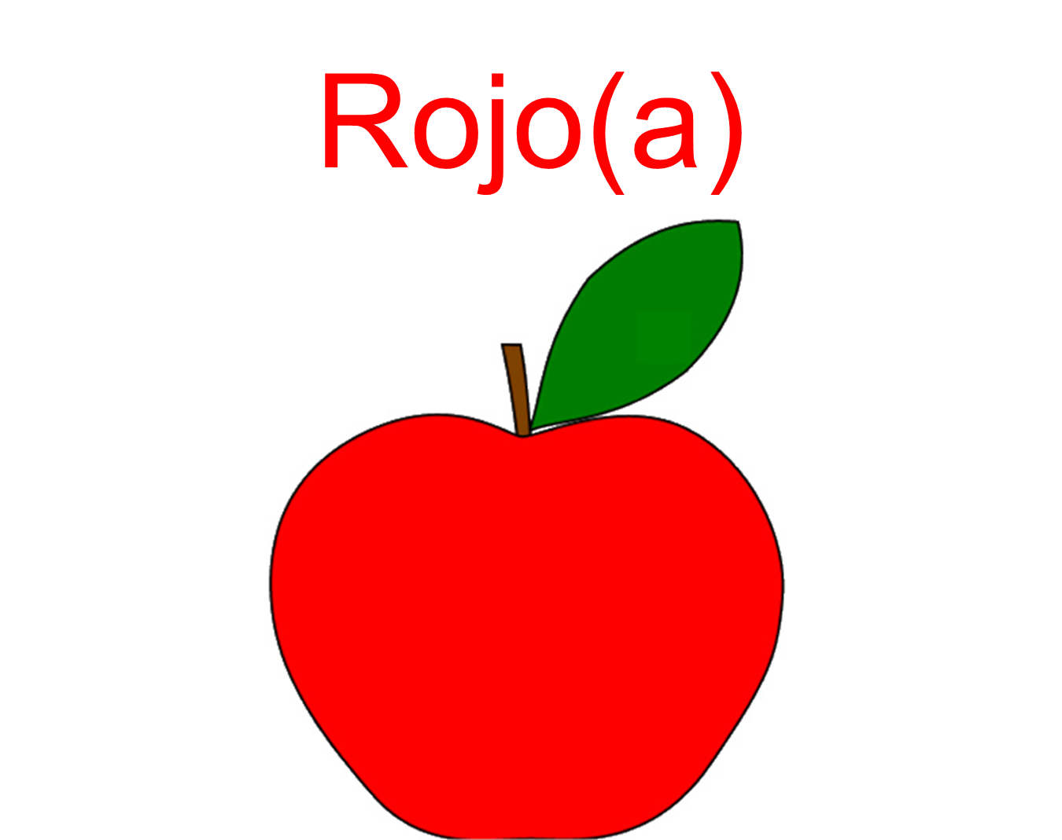
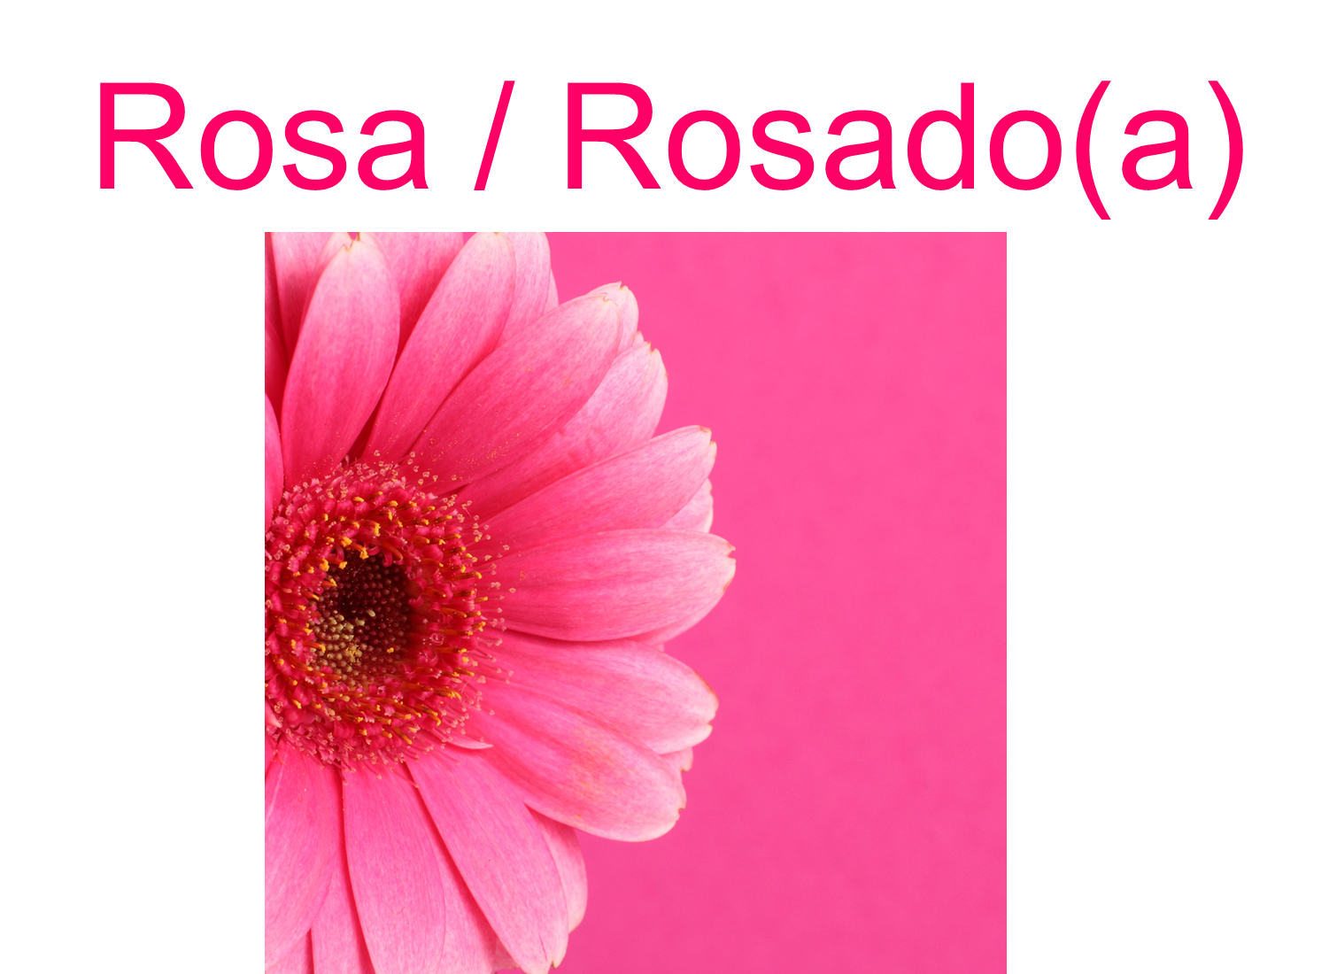
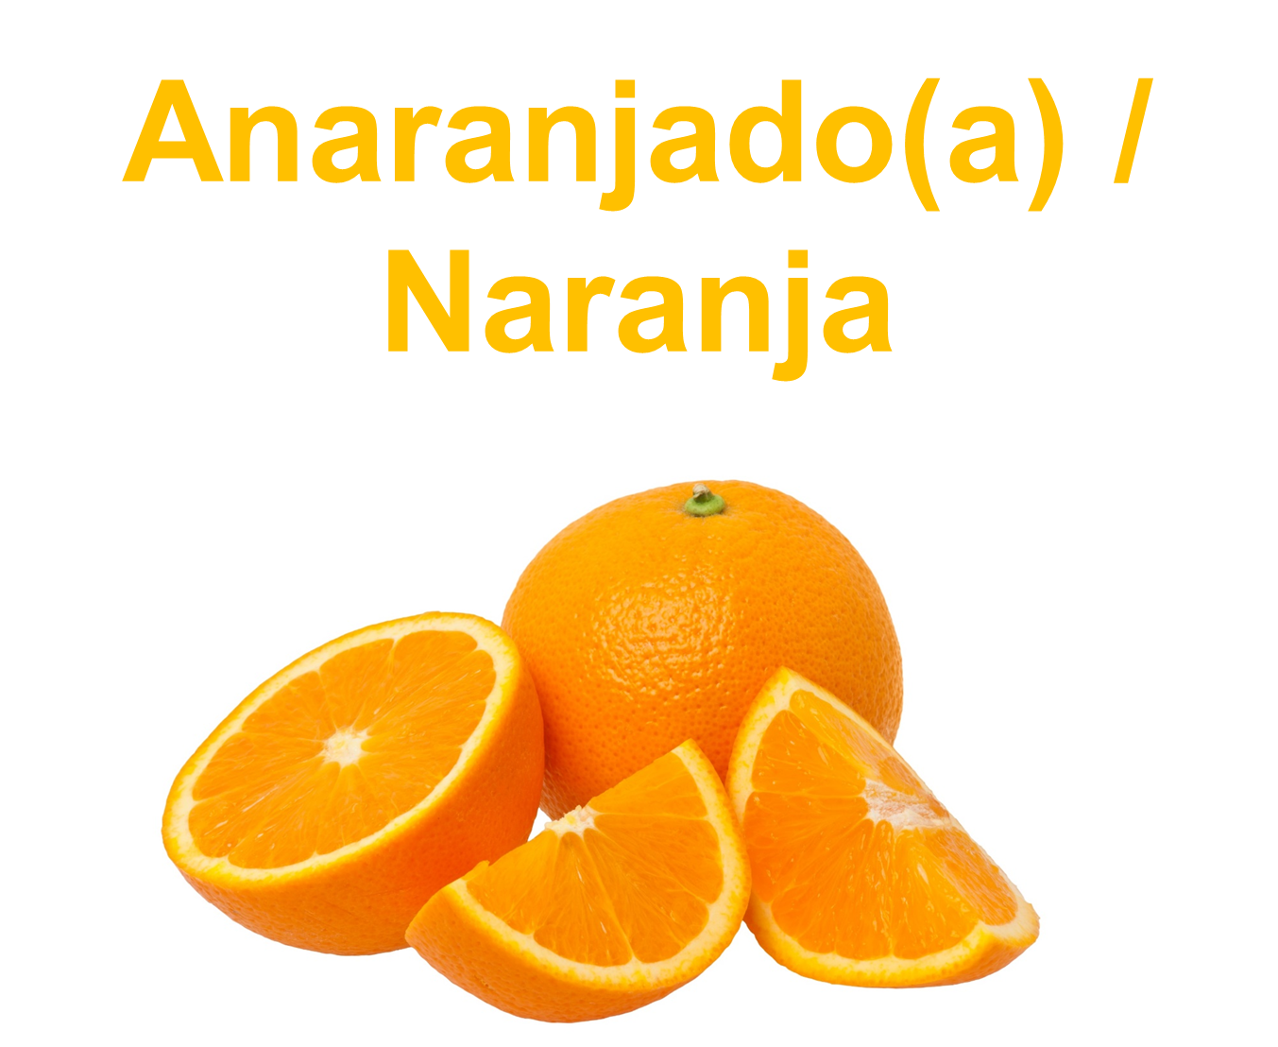

Slide 17
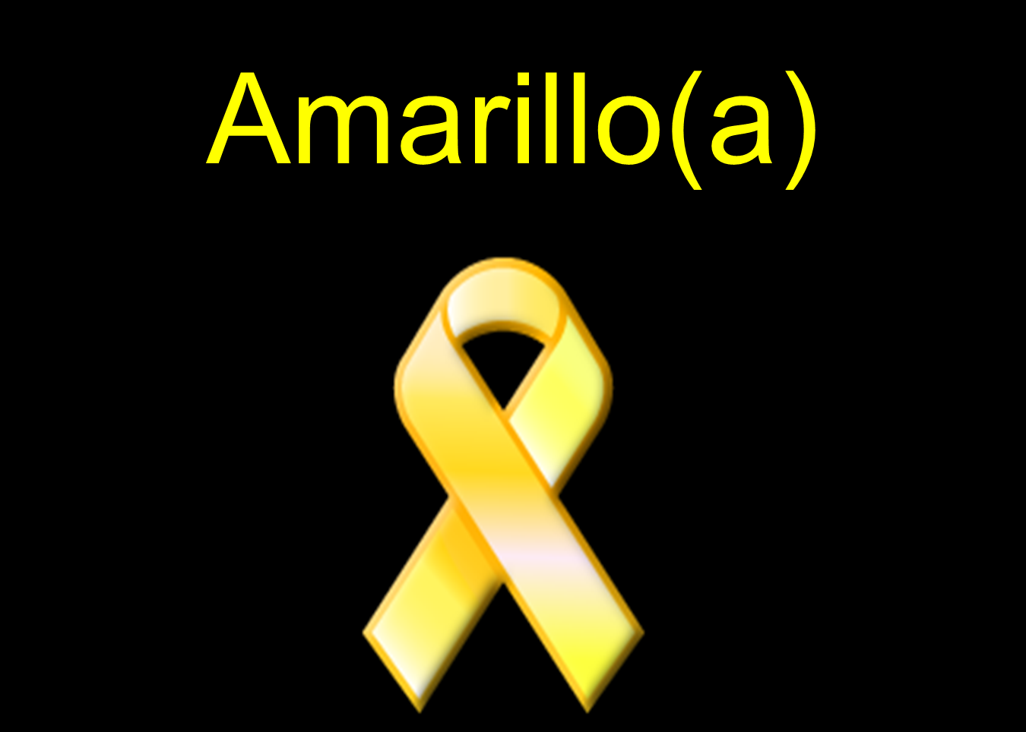

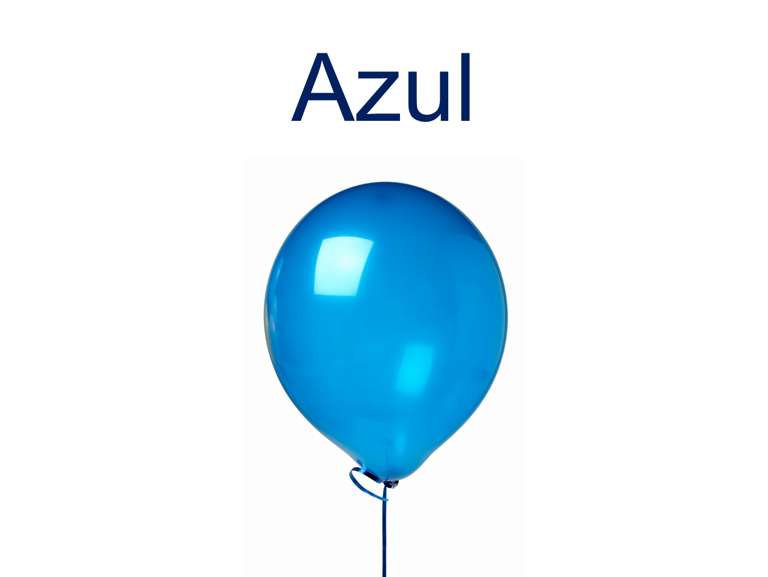
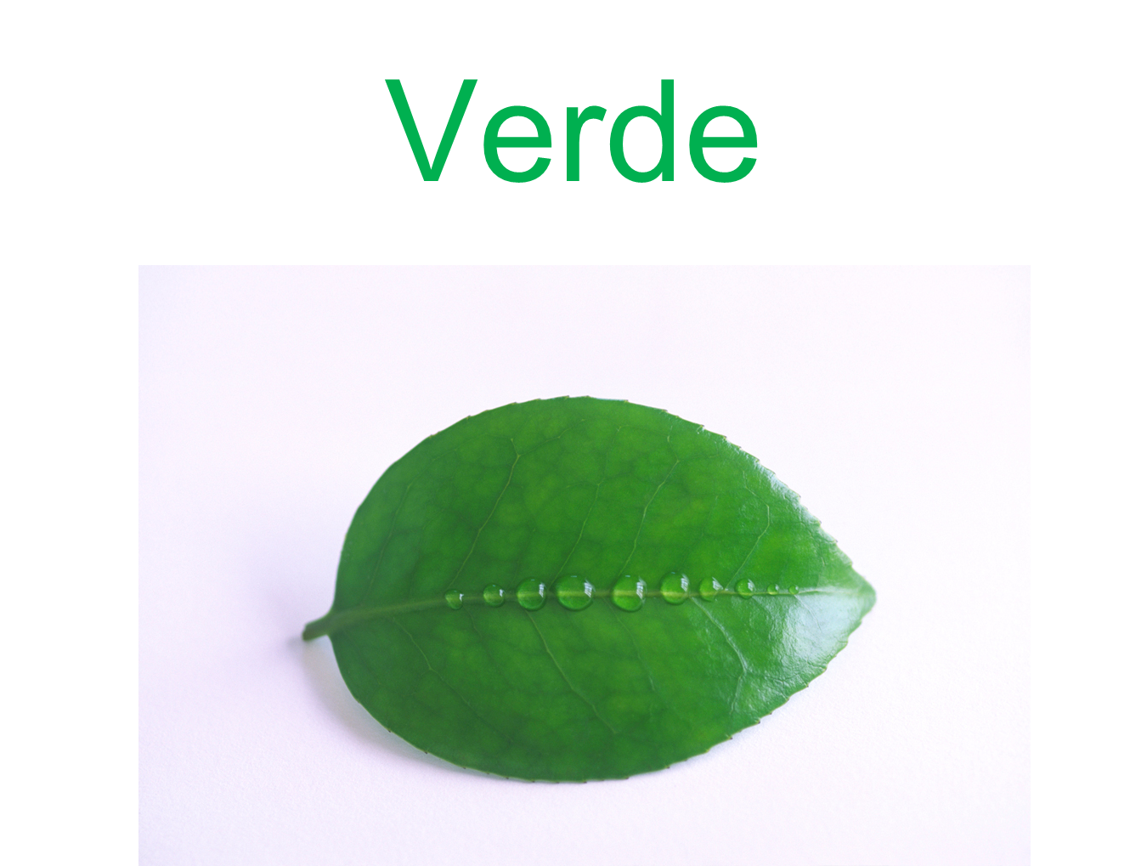

Slide 18
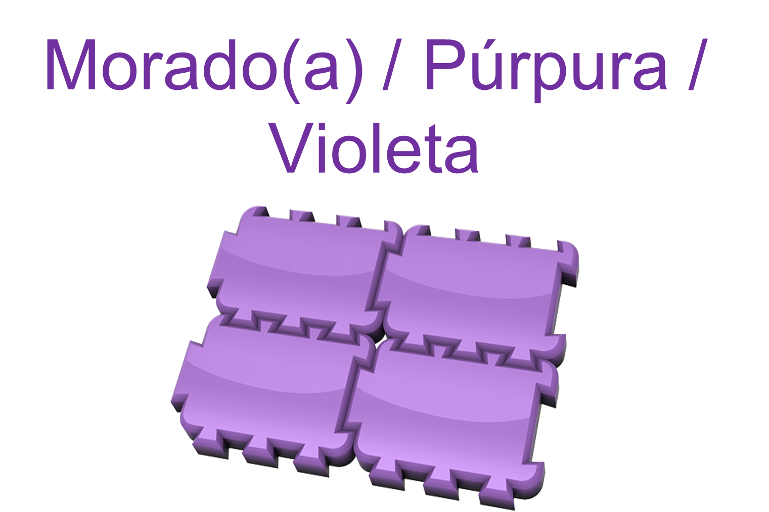
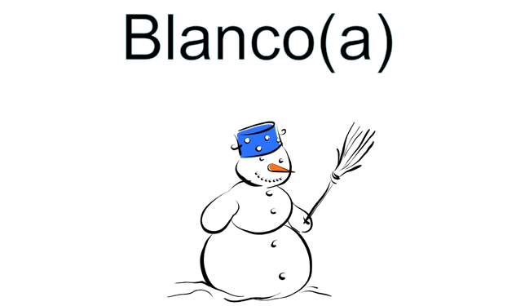
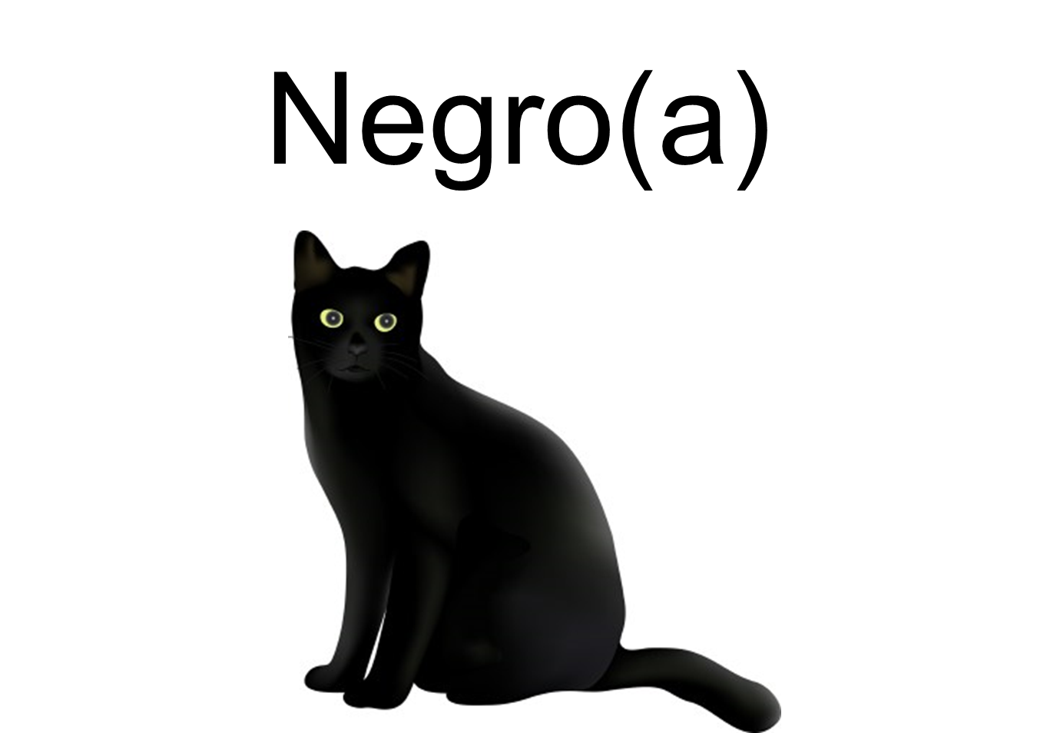


Slide 19
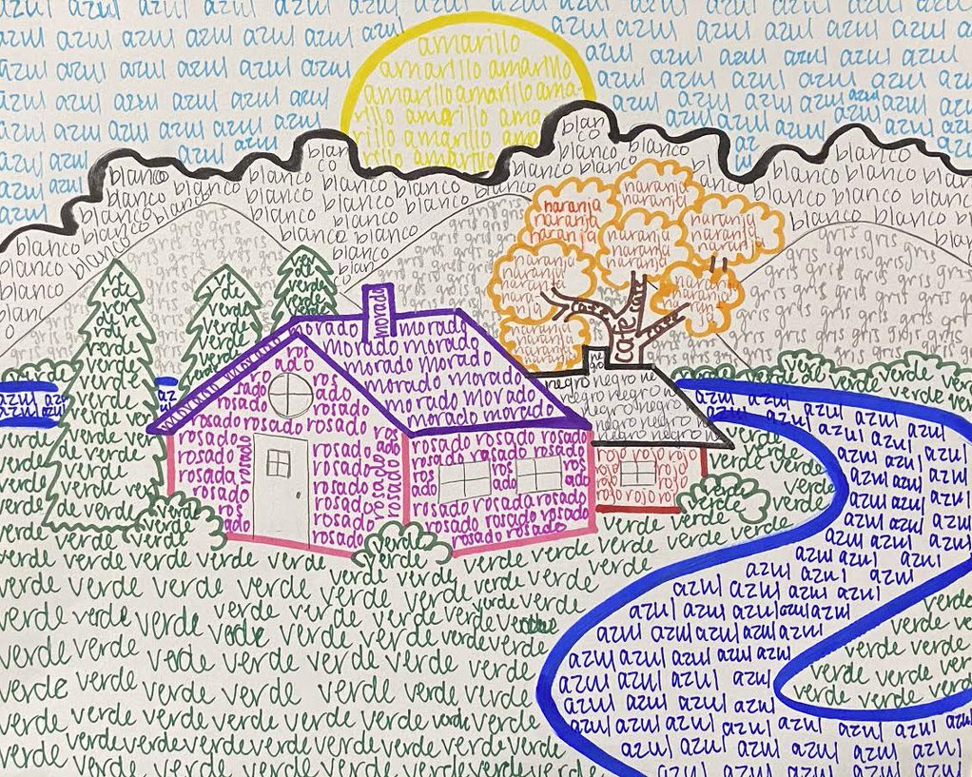
Independent Work Session:
Complete your own color drawing. You should use at least 9 of the colors we learned.

